Slide 1

Sample Size Planning Concepts: What is statistical power?
Keith R. Lohse, PhD, PStat
Associate Professor in Physical Therapy and Neurology
e: lohse@wustl.edu

Slide 2
Statistical Power
Statistical power is the probability of obtaining a statistically significant result assuming some real effect exists.
 | Reality
Decision | H₀ is True | H₀ is False
Reject H₀ | Type 1 Error (FP) | TP
Fail to Reject H₀ | TN | Type 2 Error (FN)
To make a decision, we will be conducting a hypothesis test.
We need to control the Type 1 Error rate (α).
Power comes reducing the Type 2 Error rate (β).
Power = 1- β
Power = TP/(TP+FN)
But note, we don’t know if H₀ is true or false in reality, so we have to make assumptions!

Slide 3
Statistical Power
A detailed discussion of statistical power and how it is calculated in different designs is beyond our scope.
However, there are some important considerations for researchers:
Studies should present some justification for sample size/consideration of statistical power.
Power depends on specific dependent variables and statistical tests, there is generally no single power calculation that covers a whole study.
This is part of why designating a primary outcome is so important.
A power calculation is only as good as it’s assumptions (e.g., if I assume the true effect is enormous, I only need to study ten people… but is that a good assumption?)

Slide 4
What affects statistical power?
Across different types of statistics, the same factors affect power.
Effect Size
Variance
Sample Size
More Certain
Less Certain
Math!

Slide 5
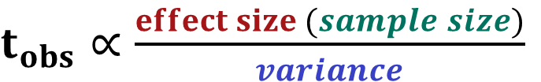
What affects statistical power?
Can you make the effect bigger? (e.g., larger doses, longer interventions?)
$t_{obs}∝\frac{effect size (sample size)}{variance}$
Can you reduce the variance? (e.g., tighter I/E criteria, use of covariates?)
Effect Size
Variance
Sample Size
Can you make the sample bigger? (e.g., recruit more subjects, collect more observations?)
What level of α or β is desirable?
More Certain
Less Certain
Math!
Or could you change the design to within subjects?

Slide 6
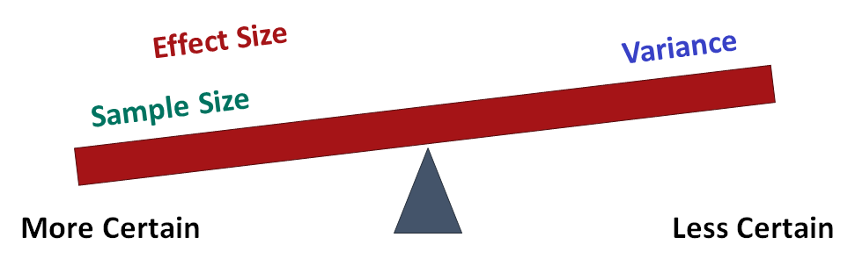
Approaches to power? (t-test example)
Sensitivity (Achieved Power): “We are only able to recruit N=30, therefore we only have 80% statistical power to detect effects of size d (true effect/true variance ratio) when α=0.05.”
A Priori Power: “Assuming the true effect/true variance ratio is d=0.5, then we need N people to achieve 80% statistical power (α=0.05).”
Post-Hoc Power (DO NOT USE): Assume the true effect is equal to the observed effect, then calculate the power you had to detect an effect of that size. [This is just a re-statement of your NHST! See Althouse, 2021]

Slide 7
What is a null hypothesis?
The null-hypothesis is the hypothesis “to be nullified”.
We make a set of assumptions (our null hypothesis),
if our data strongly conflict with those assumptions, then we reject the null hypothesis.

Slide 8
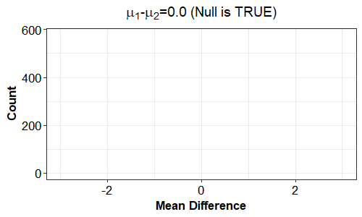
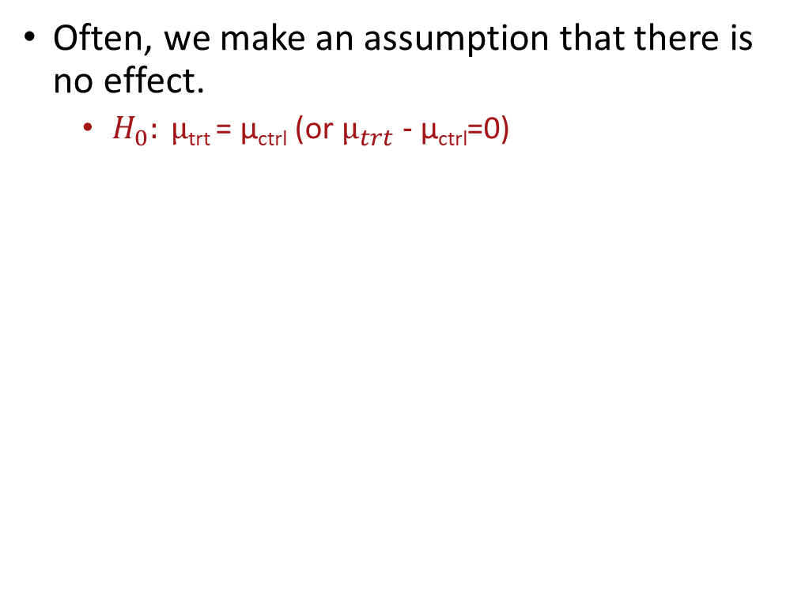
What does a null hypothesis look like?
Often, we make an assumption that there is no effect.
$H_{0}: μ\text{trt}\text{ = }\text{μ}\text{ctrl}\text{ (}\text{or} μ_{trt}\text{ − }\text{μ}\text{ctrl}$=0)
The Null-Distribution

Slide 9
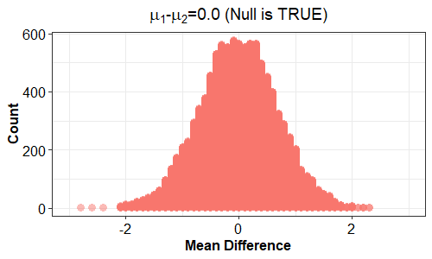
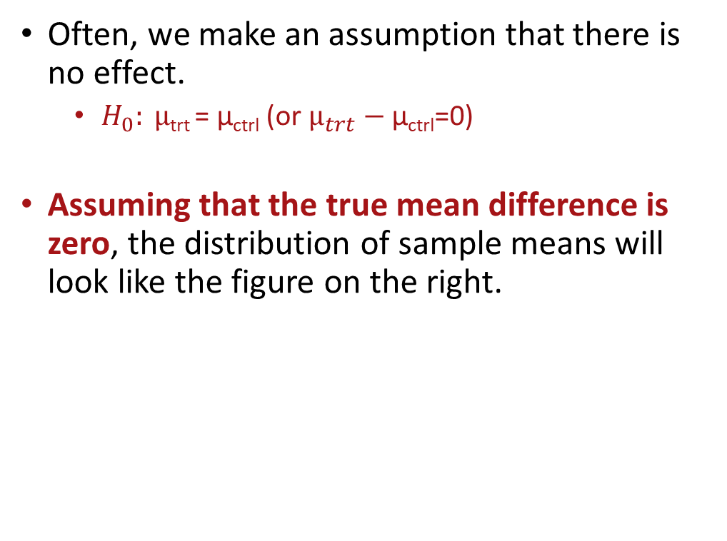
What does a null hypothesis look like?
Often, we make an assumption that there is no effect.
$H_{0}: μ\text{trt}\text{ = }\text{μ}\text{ctrl}\text{ (}\text{or} μ_{trt}\text{ − }\text{μ}\text{ctrl}$=0)
Assuming that the true mean difference is zero, the distribution of sample means will look like the figure on the right.
The Null-Distribution

Slide 10
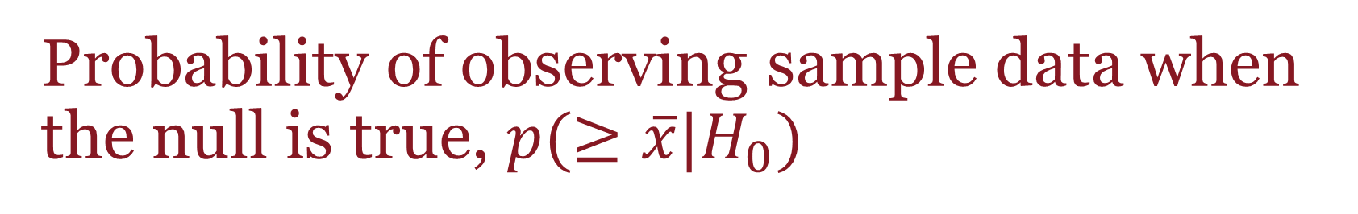
Probability of observing sample data when the null is true, $p(≥\overline{x}|H_{0})$
So, let’s say that you observed a mean difference of x=0.5. Is that statistically interesting?
No, under the null hypothesis, a mean difference of 0.5 is well within the bounds of what we would expect due to sampling variability alone.
The Null-Distribution

Slide 11
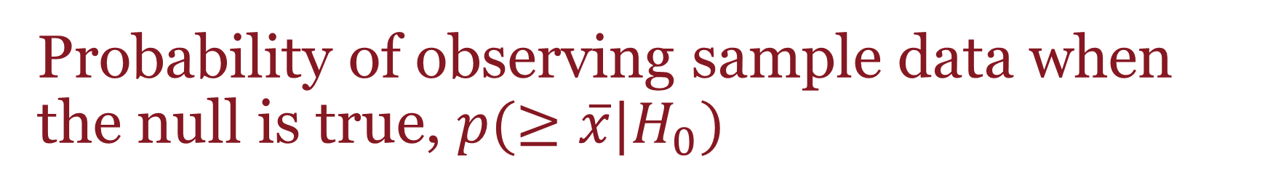
Probability of observing sample data when the null is true, $p(≥\overline{x}|H_{0})$
So, let’s say that you observed a mean difference of x=3.0?
Yes, under the null hypothesis, a difference this large is very unlikely to arise.
Thus, we would reject the null hypothesis as an explanation for these data.
The Null-Distribution

Slide 12
Probability of observing sample data when the null is true, $p(≥\overline{x}|H_{0})$
So, let’s say that you observed a mean difference of x=1.5?
Maybe?… under the null hypothesis, a 1.5 is unlikely, but how unlikely does it need to be?
The Null-Distribution

Slide 13
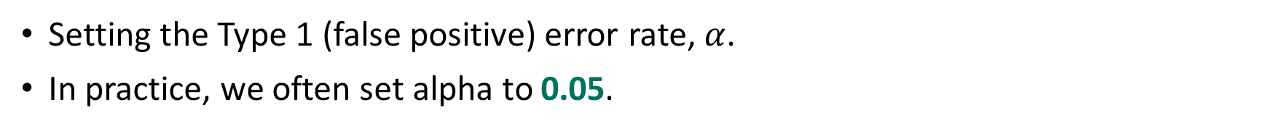
α – Controlling the Type 1 Error Rate
Setting the Type 1 (false positive) error rate, $α$.
In practice, we often set alpha to 0.05.
95%
2.5%
2.5%

Slide 14
α – Controlling the Type 1 Error Rate
Thus, when the null-hypothesis is true, we would only erroneously reject it about 5% of the time. (2.5%+2.5% = 5%)
95%
Note that 5% is about the same as flipping four heads in a row.
2.5%
2.5%

Slide 15
α – Controlling the Type 1 Error Rate
To be more conservative, we could set alpha lower – demanding a higher standard in order to reject the null hypothesis.
99.9%
Note that 5% is about the same as flipping four heads in a row.
0.1% is about the same as flipping 10 heads in a row.
0.05%
0.05%

Slide 16
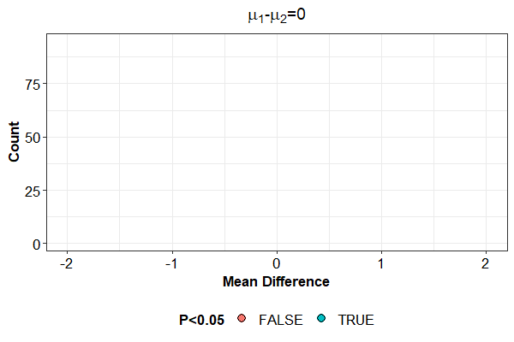
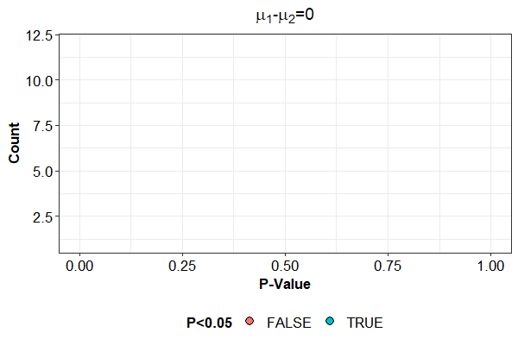
Simulated samples under the null
n/group = 10

Slide 17
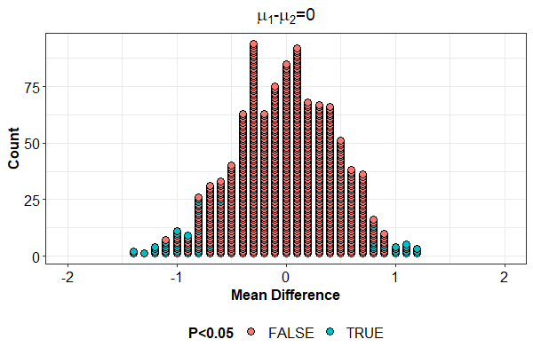
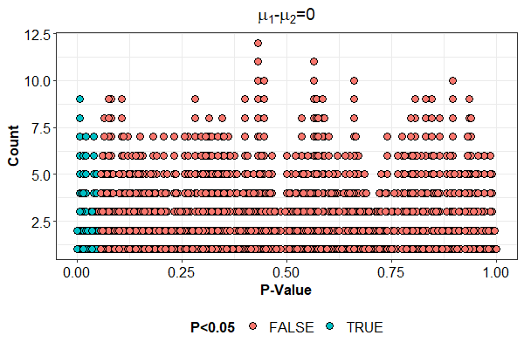
Simulated samples under the null
n/group = 10
Extreme effects can occur by chance.
But we’ll only make the wrong decision 5% of the time (ie. reject then null when it’s true).

Slide 18
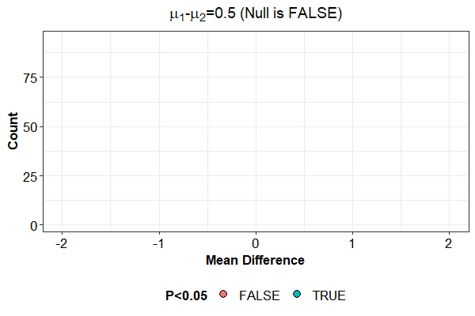
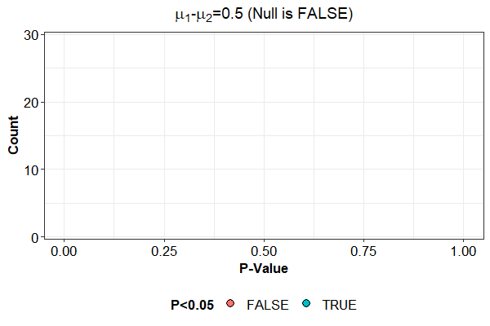
Simulated Samples under the alternative (d=0.5)
n/group = 10

Slide 19
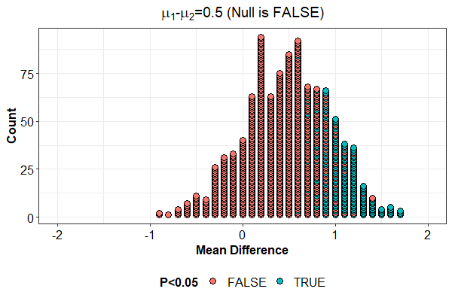
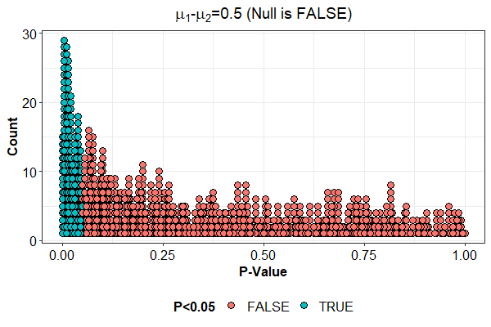
Simulated Samples under the alternative (d=0.5)
n/group = 10
19% correct rejections, assuming alternative is true.
81% Type 2 errors, assuming alternative is true.
Extreme events still occur; statistically significant effects are bad estimates of the true effect [“winner’s curse”].
Which is kind of terrible, so how can we make it better?

Slide 20
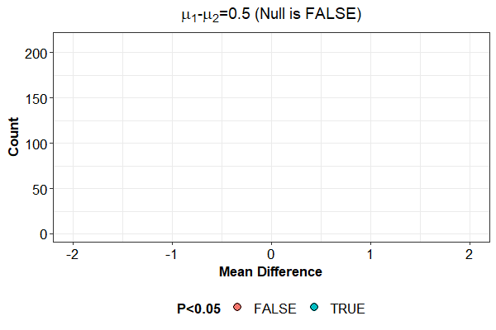
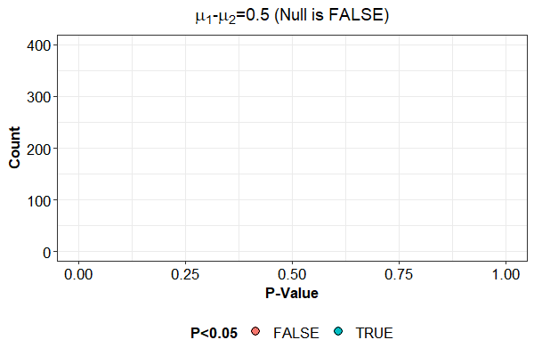
Improving power under the alternative (d=0.5)
n/group = 64

Slide 21
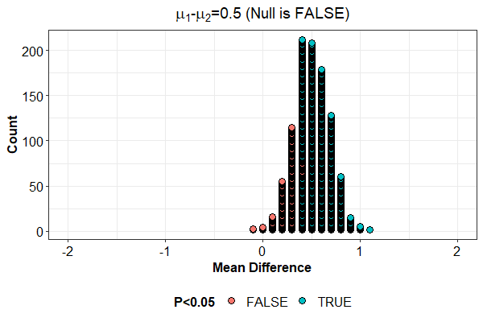
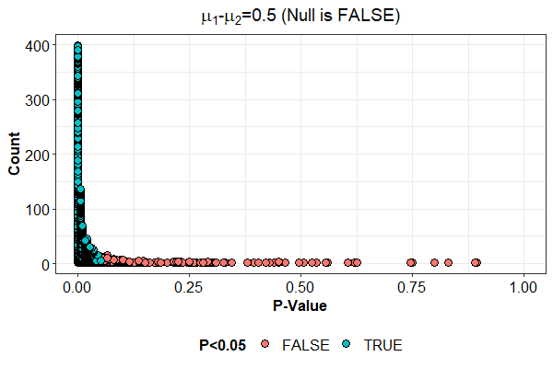
Improving power under the alternative (d=0.5)
n/group = 64
80% correct rejections, assuming alternative is true.
20% Type 2 errors, assuming alternative is true.
In an absolute sense, extreme observations are less likely.
But we had to recruit N=128 subjects to do that!

Slide 22
To Recap…
Statistical power is the probability of obtaining a statistically significant result, assuming that a particular true effect exits.
Sample size, effect size, and variance all interact to affect statistical power.
Statistical power is highly contextual, specific to a particular hypothesis test and outcome measure. No one power calculations covers a whole scientific study.

